Slide 1
DSO 545 – Final Project
311 Call Center Tracking Data for City of Los Angeles

Slide 2
Agenda
Objectives
Exploratory Analysis
Distribution of Request Type
Distribution of Assigned Departments
Sources of Requests
Requests Breakdown by Day/Hour
Further Analysis of Top 3 Request Types
Conclusions
Recommendations
KPI Development
Shiny Dashboard

Slide 3

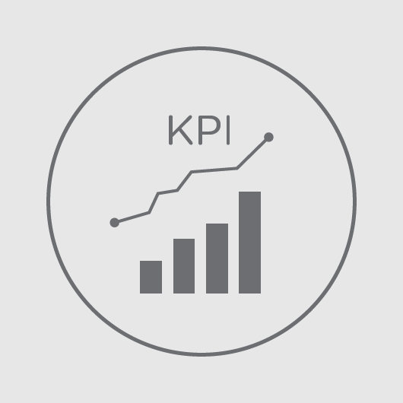


Objectives
Identify and visualize overall trends and patterns of service requests
Identify key performance issues, design a Key Performance Indicator (KPI), and identify best and worst performing cases
Provide insights and improvement recommendations to worst performing cases
Develop an online monitoring tool in Shiny to facilitate and improve 311 team’s future work flows

Slide 4
Exploratory Analysis

Slide 5
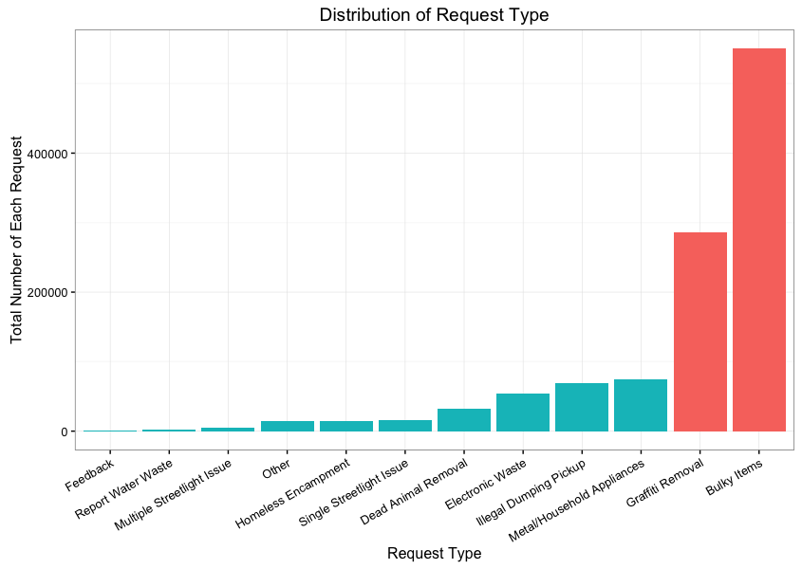
Distribution of Request Types
Top 3 categories constitute of >80% of requests
Bulky Items
Graffiti Removal
Metal/Household appliances
Focus on these three categories in further analysis
Indicates resource allocation requirements
Helpful to identify pain points across the city

Slide 6
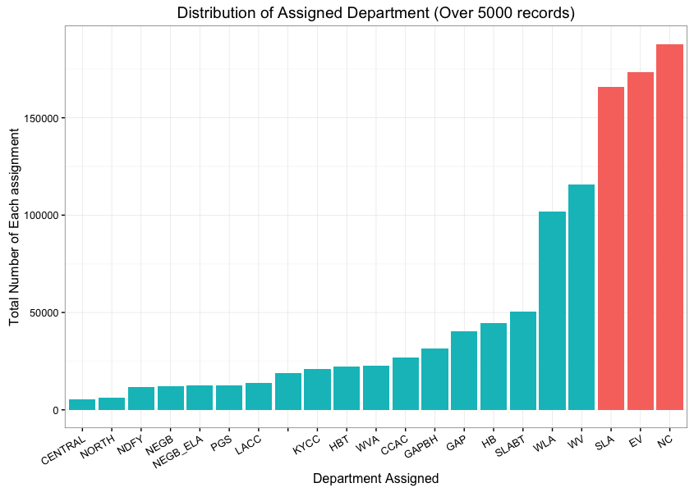
Distribution of Assigned Departments
Highly skewed distribution with NC, EV and SLA having majority of assignments
Not enough information for further analysis
Useful data for further analysis:
Functions of each department
Resource allocation for each department
Labor + capacity information
Cross-departmental work opportunities

Slide 7
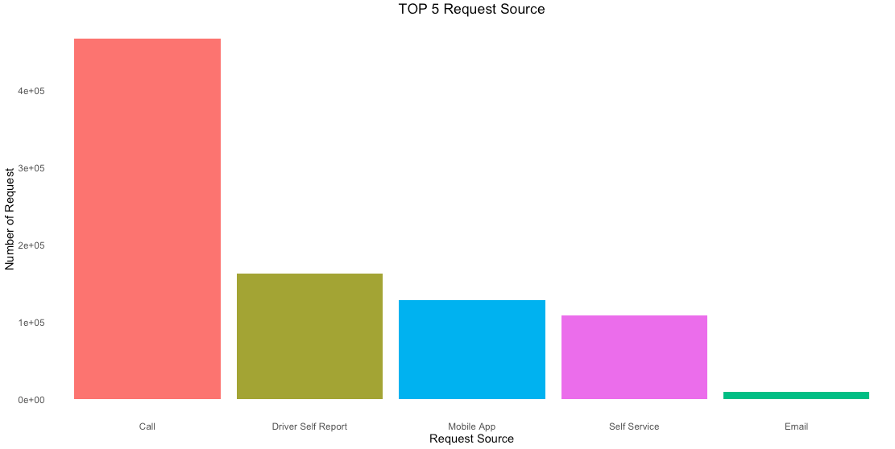
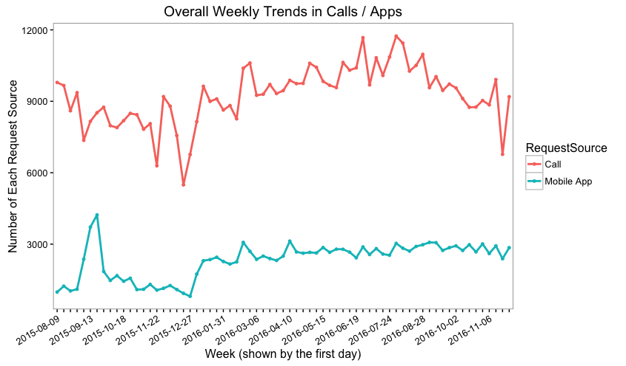
Sources of Requests
Phone calls is the primary way of requesting a service
It is advisable to improve requests through apps to reduce labor intensive phone calls
App adoption rate is not significant
Further analysis of phone v/s app users would be helpful to understand the user behavior and promote mobile app

Slide 8
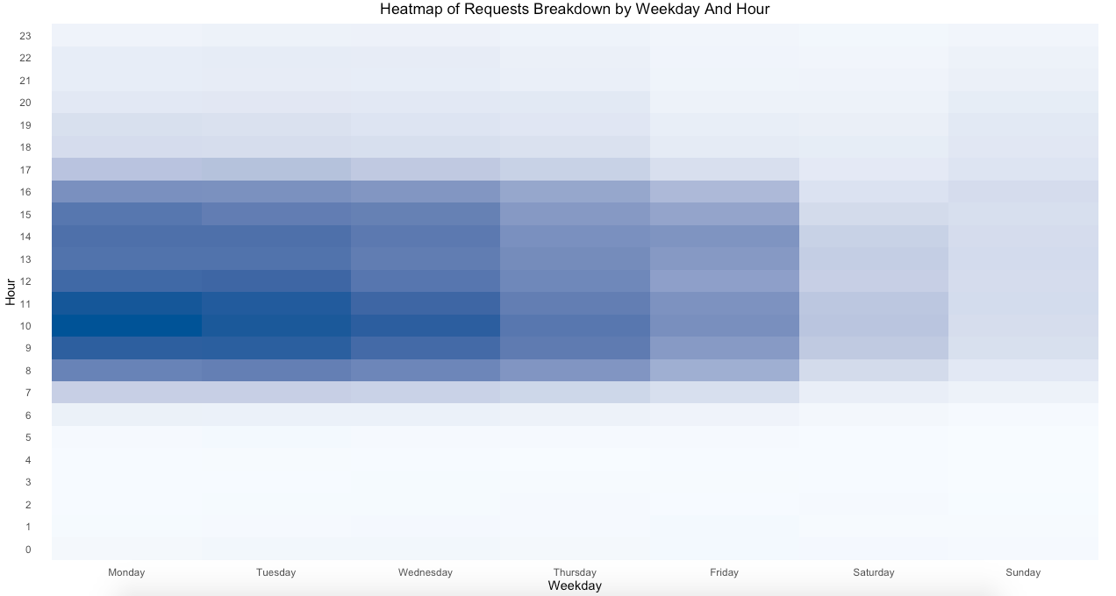
Requests Breakdown by Day/Hour
As can be expected, most of the services are requested during work hours on weekdays
This is possibly because of working hours of call center
Most of the requests tend to be between 9-11 AM on Mondays through Wednesday
311 can allocate its resources accordingly
They should consider extending their service hours to ease the peaks
Flexible staffing is the key to manage peaks and lows

Slide 9
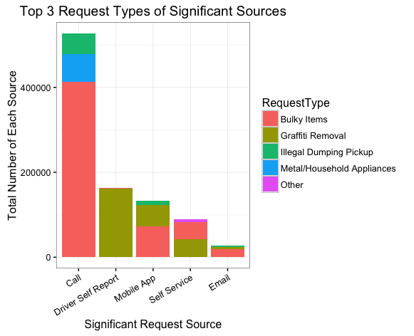
Further Analysis of Top 3 Request Types
Although majority of calls are about bulky items, driver self reports are almost exclusively about the graffiti removal
Having a dedicated specialized team for bulky items would greatly improve the call center’s efficiency
Trends across different districts(see appendix)
Bulky Items: Districts 6, 8 and 13 perform below average
Graffiti Removal: Districts 9, 13 and 14 are way below average, especially district 9
Metal/Household Appliances: Districts 8 and 12 are the worst performers
Visualization for each district is an effective way to keep track of performance and manage resources

Slide 10
Recommendations

Slide 11
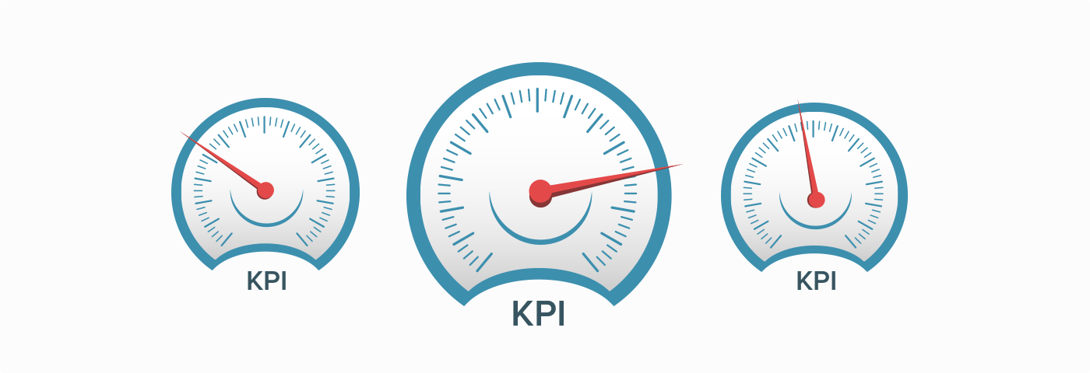
Key Performance Indicator
District Inconvenience Index
Consists of→
Total number of requests
Duration of service time
Population density
Districts with High number of requests, High population density, and Long service duration will be highlighted and considered as poor performance districts
Based on the data of last 3 months, districts 9, 10 and 12 are identified to have high value of district inconvenience index

Slide 12
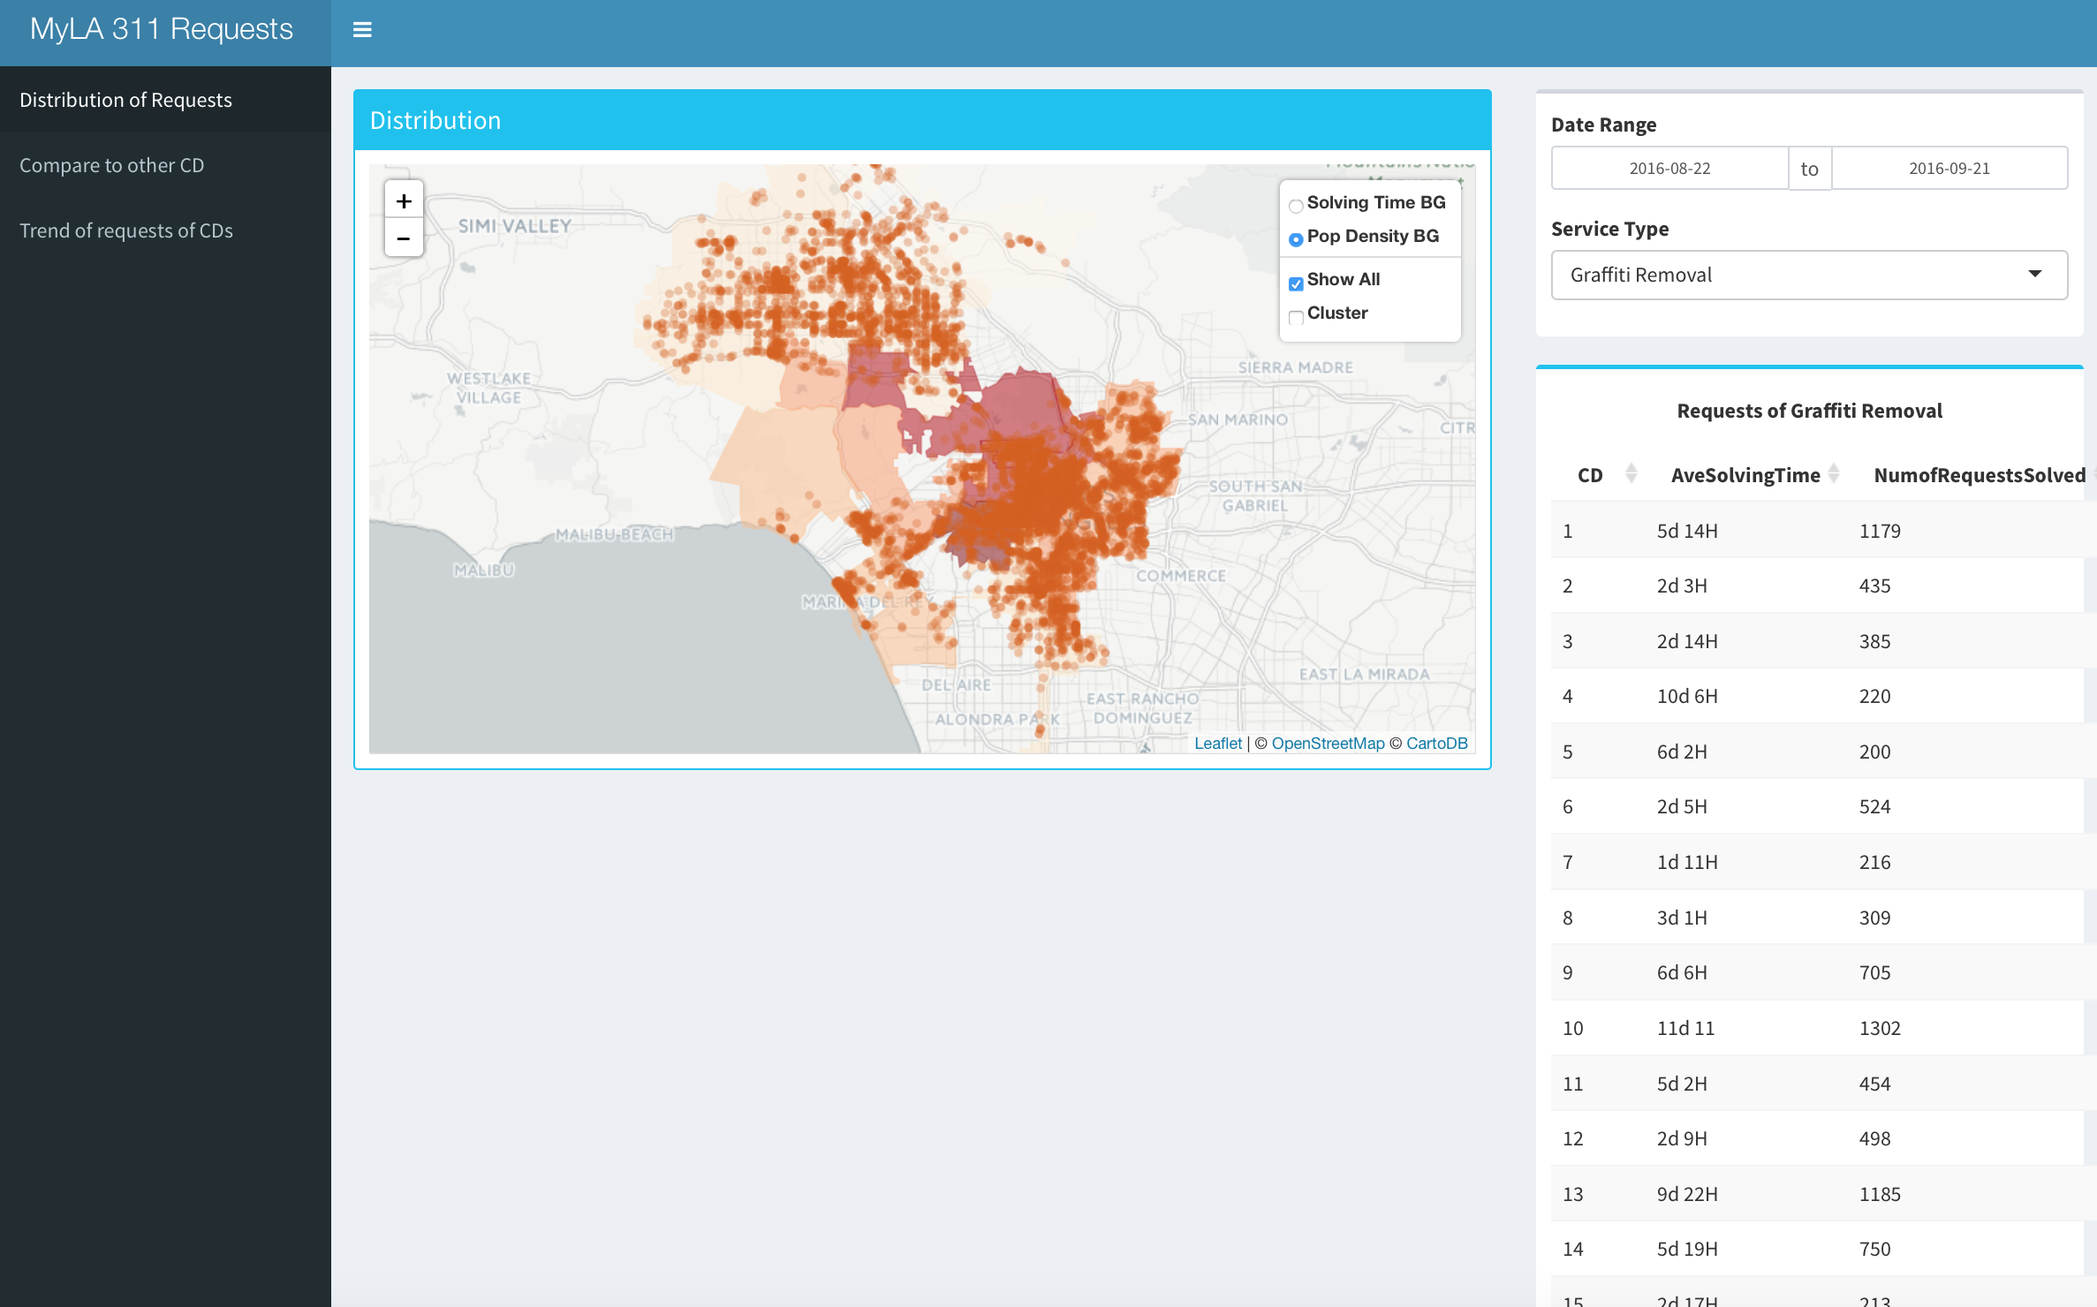
Shiny Dashboard
Shiny Dashboard enables:
Using real time data directly from 311 website and building interactive visualization based on any input period of time
Display of geographical distribution of different requests in map
Comparison (1 )between CDs within same period of time & (2) between different periods of time in the same CD
Generating and sharing reports

Slide 13
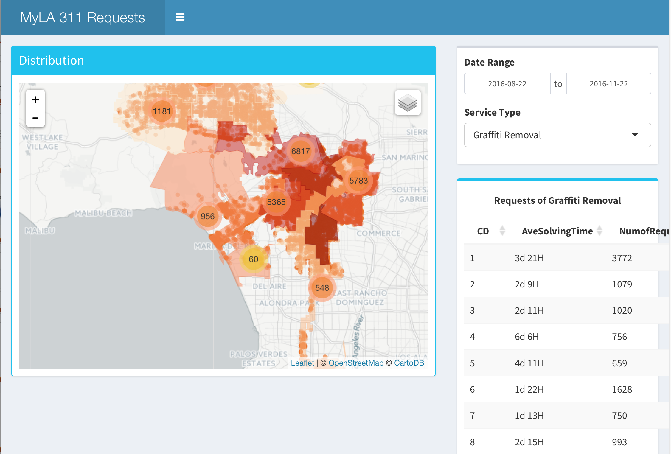
Shiny Dashboard
The District Inconvenience Index can be used to design dashboards to track district performance dynamically
This prototype dashboard can be used to filter based on different criteria, get more detail etc.
It can be further developed and deployed at 311 to improve the quality and efficiency of services delivered

Slide 14
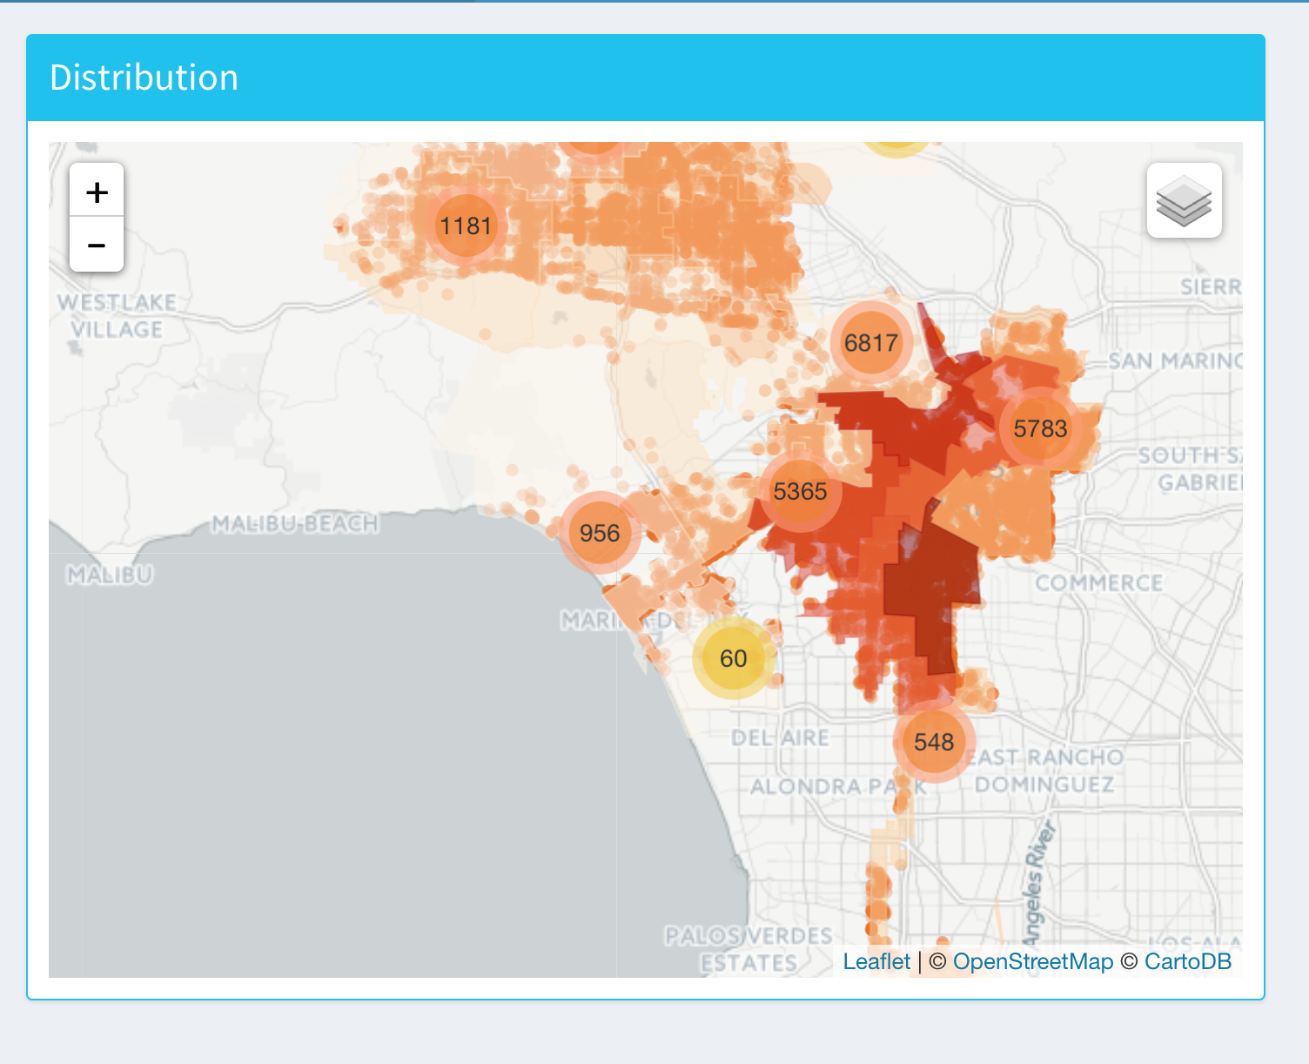
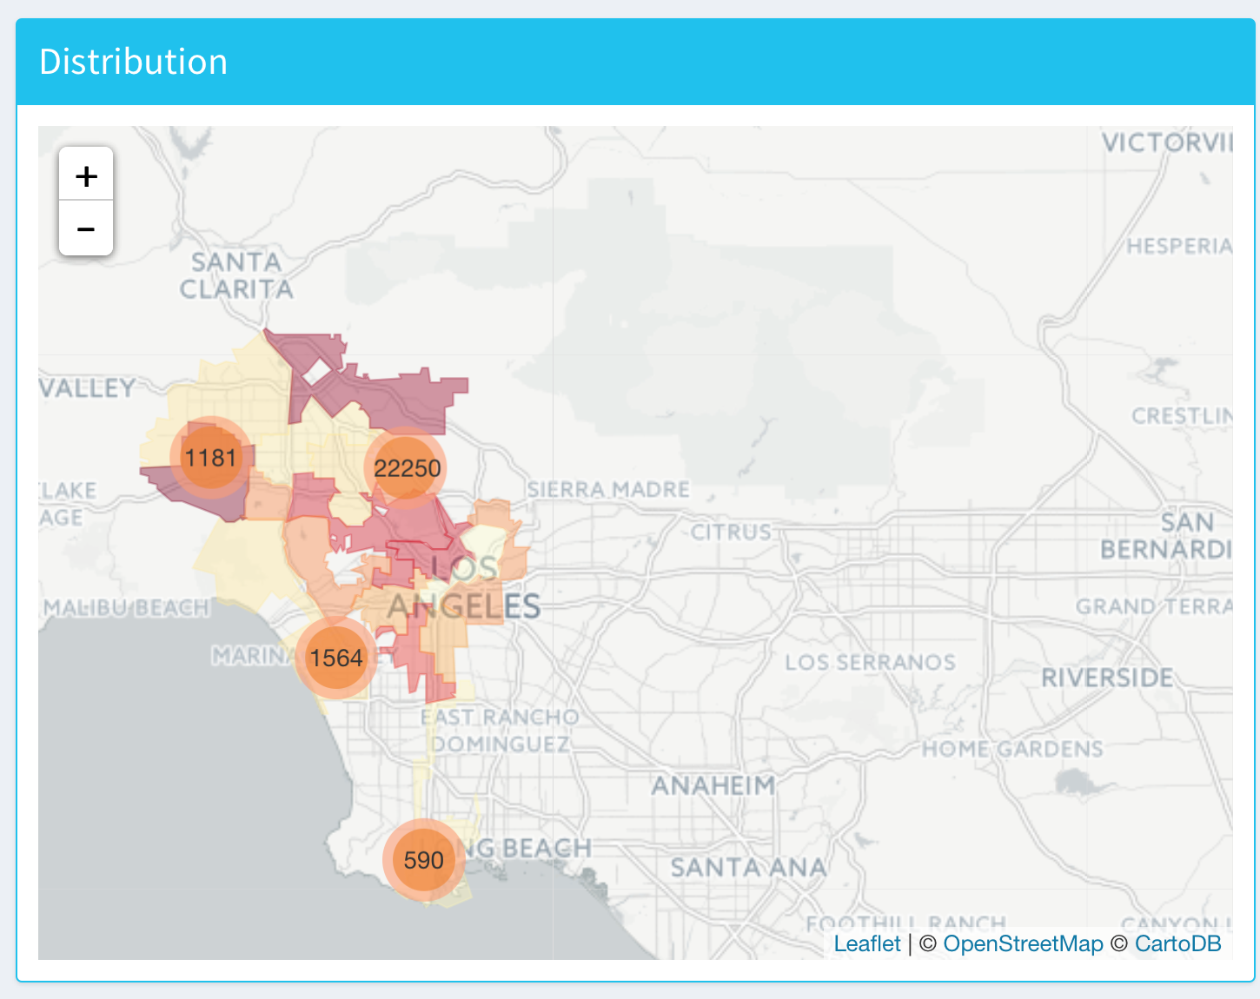
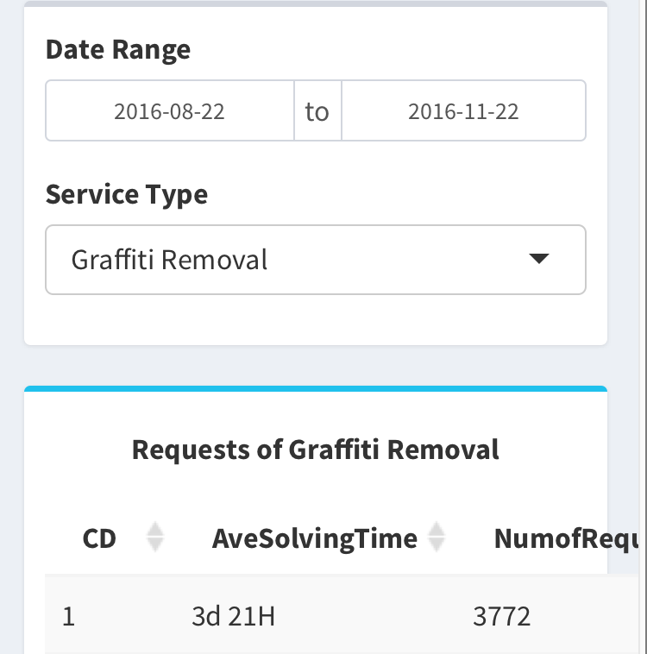
Shiny Dashboard

Slide 15
Thank You

Slide 16
Appendix

Slide 17
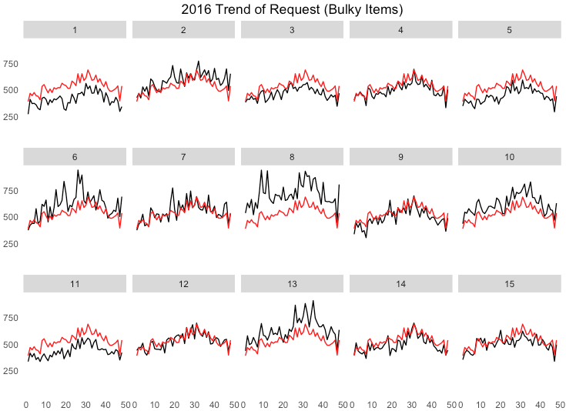
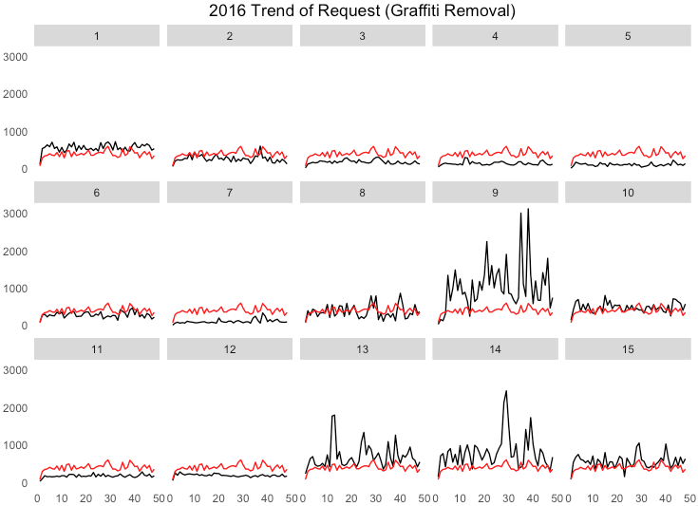
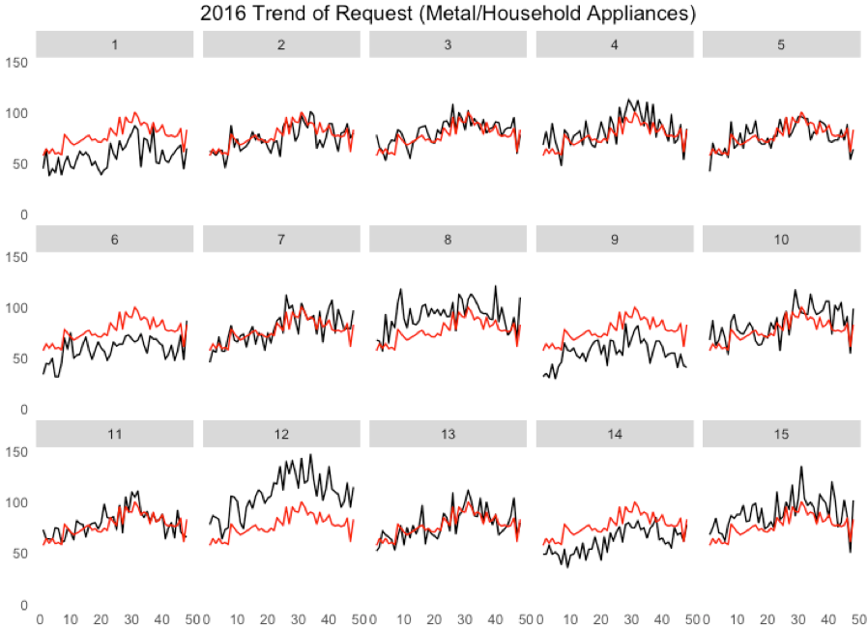
Trends of Top Requests Per District

